Slide 1
Investigating the Computer Security Practices and Needs of Journalists
By Susan McGregor, Polina Charters, Tobin Holliday, and Franziska Roesner
Presented by Ben Summers

Slide 2
Clark Kent and Security
Clark Kent is just like any other journalist – he needs secrecy and security to do his job!
Journalists and their sources are at increased risk of identification, prosecution, and persecution by powerful entities.

Slide 3
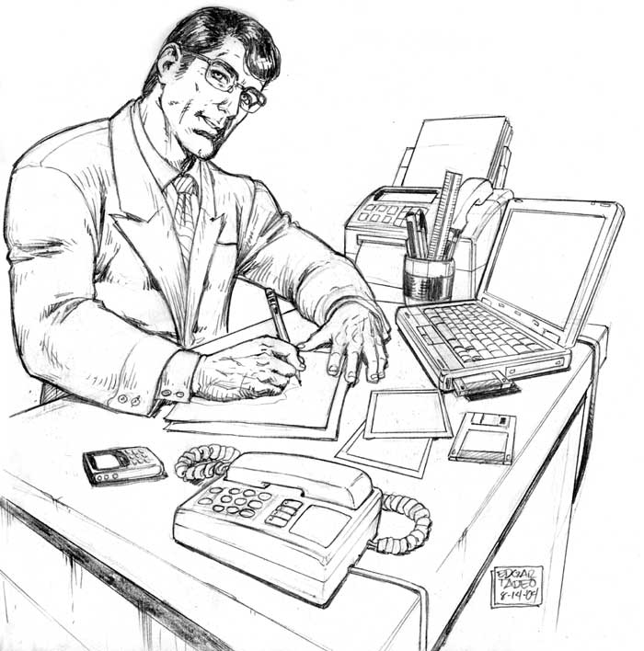
Research Problem
How can the computer security community understand the practices, constraints, and needs to journalists to protect journalist-source communications?
The researchers want to collaborate between researches in journalism and computer security communities to fulfill journalistic needs.

Slide 4
Research focus
Researchers wanted to shed light on general practices, security concerns, defensive strategies and needs of journalists in their communication with sources.
Anonymous journalists from major news organizations from the US and France answered surveys.
More than one journalist said that they have been the direct targets of threats like eavesdropping and data theft – the need for security is real.

Slide 5
Existing Solutions & Limitations
Anonymous communication tools fail when they compromise source authentication – even SecureDrop, which was developed for journalists, suffers from this limitation.
Built-in encryption is widely used because of its ease of use and does not require explicit installation.
The Digital Divide, inaccessibility to technology because of economic or social factors, limits the use of sophisticated security tools.

Slide 6
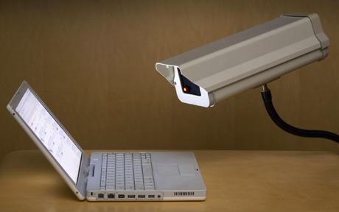
Primary Concerns of Journalists
Government surveillance and increased risks to confidentiality have created a “chilling factor” among sources to discuss sensitive topics.
Secure browsing and communication are most needed but established technologies are at odds with journalistic needs and access issues among the most vulnerable source populations.

Slide 7
Novelty
The study’s interviews with journalists aims to provide the developers of new technologies with a deep, grounded understanding of the needs and security concerns of journalists.
The paper exposes current gaps in security for journalists and makes recommendations to improve the limitations of existing security applications and tools.

Slide 8
Outline
Introduction
Methodology
Results
Defensive Strategies
Needs of Journalists
Discussion
Conclusion and Questions

Slide 9

Methodology
The researchers interviewed 15 journalists from six news organizations from France and the US.
They asked questions about how the journalists communicated with a source, general questions about security practices, and specific questions about security tools.

Slide 10
General Questions
Researchers asked:
Note-taking and storage processes
Problems that would arise if digital notes were compromised
Non-technological strategies used to protect themselves
Security problems they’ve encountered
Kinds of devices they use and who owns them
Self-described comfort level with technology and security.

Slide 11
Outline
Introduction
Methodology
Results
Defensive Strategies
Needs of Journalists
Discussion
Conclusion and Questions

Slide 12

Results
Journalist-source communications are often driven by the source – journalists went with the comfort level, capacities, and preferences of sources.
The Digital Divide, which source populations do not have access to or knowledge about technology presents a serious challenge.
The study revealed security concerns and usability and adoption challenges.

Slide 13

General Issues
There is a need among journalists for more general knowledge management platforms.
Journalists regularly used ad hoc defensive strategies to address surveillance concerns
Despite existing tools, journalists desperately want more effective ways to protect information in filenames and notes, to authenticate sources, and to obfuscate communications meta.

Slide 14
General Practices
Finding Sources – Long-term sources pose security challenges as it may be hard to protect metadata about communications over a long period
Communicating with sources – security tools were used only in exceptional cases where the context was known in advance
Building Trust – Techniques vary on how to get sources to trust the journalist
Communication Tools – Primary tools are phones, SMS, and email with some informal meetings. Storage technologies are often used.

Slide 15
General Practices Cont.
Devices and accounts – Participants regularly separate personal and professional accounts but often use external or unencrypted storage facilities.
Ownership – Many organizations have administrative access to devices and accounts.
Note-taking – Many journalists like audio-recording and electronic notes but do not share their notes with external sources. Most store notes on third-party platforms.
Knowledge Management – Multiple journalists cited a lack of a good knowledge management tool.

Slide 16
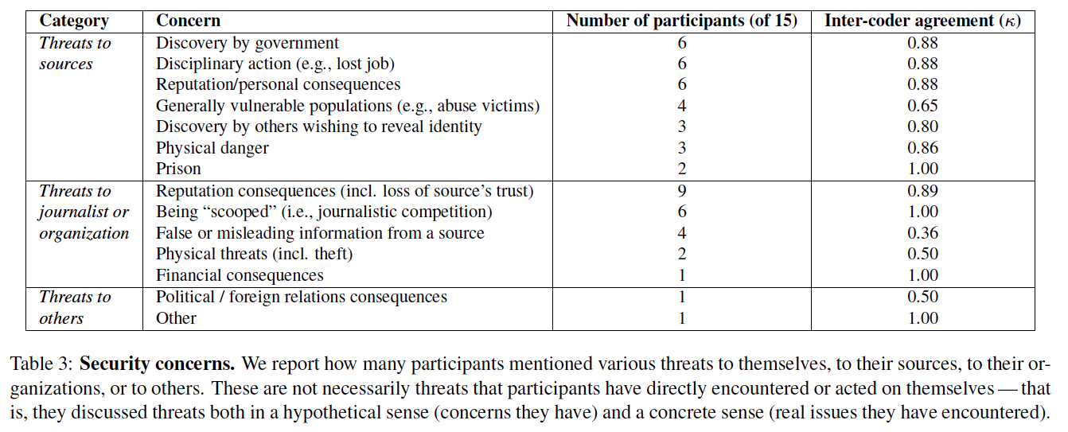
Security Concerns

Slide 17
Security Concerns
Some journalists have encountered direct tangible threats or harms. Many journalists mentioned knowledge or strong suspicion that digital communications have been collected.
Third Party (e.g., Microsoft, Google, Apple) security concerns and bleed from professional and personal work environments.
No journalist mentioned the need to protect metadata like they protect their notes.
No journalist mentioned the risk of lawsuit from digitally stored information being leaked.

Slide 18
Outline
Introduction
Methodology
Results
Defensive Strategies
Needs of Journalists
Discussion
Conclusion and Questions

Slide 19
Defensive Strategies
Non-technical – meeting source face-to-face, physically mailing digital data, and communicating only vague information electronically. Journalists mentioned they feel like they must “act like criminals” to communicate.
Ad Hoc – Hiding communication through an intermediary or codenames.
Technical – Journalists used encryption regularly but were divided concerning using security tools or if they had been trained.

Slide 20
Defensive Techniques

Slide 21
Reasons for using Security
The biggest challenge is that many sources do not understand or have access to security technology – Digital Divide.
Even so, few used recommended tools. Most complained about the usability of security tools and need for education.
Many cited a lack of institutional support – many participants had no one to ask for help or had to go outside their organization for help.

Slide 22
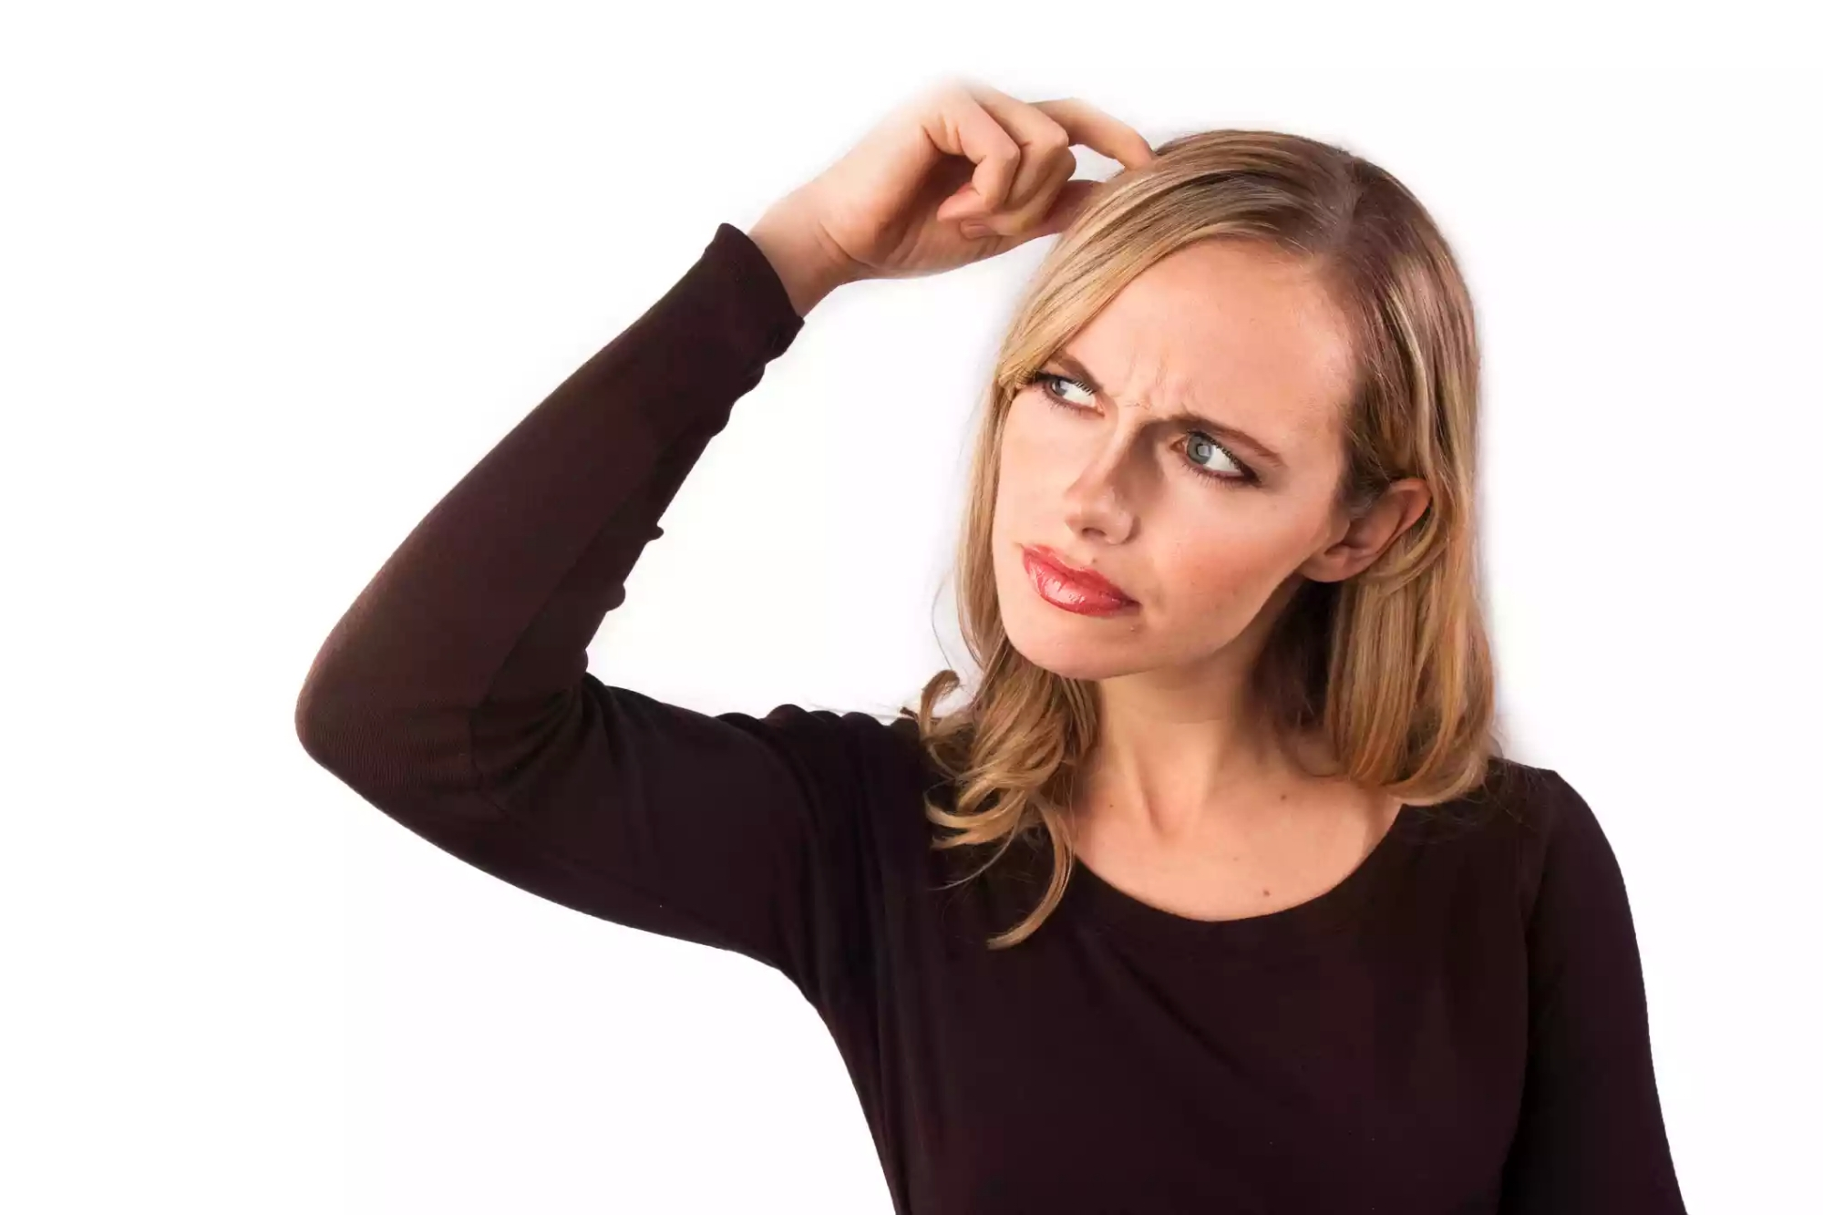
Inconsistencies
Participants frequently mentioned potential danger in their practices but did not change their behaviors.
Many could not name any security tools despite knowledge of security gaps in their practices.
Ease of use often outstripped security concerns – many journalists mentioned using iPhones and frequently used third-party document management services

Slide 23
Outline
Introduction
Methodology
Results
Defensive Strategies
Needs of Journalists
Discussion
Conclusion and Questions

Slide 24
Needs of Journalists
Resolve functions impeded by security technologies
Most journalists do not use existing tools because they interfere with some component of journalistic process
Need to resolve:
Anonymous communications – journalists must know source
Communications that are easy to use and accessible
Constraints on communication

Slide 25
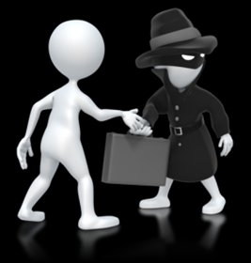
Tension between Anonymity and authenticity
A source’s communications must be anonymous to everyone but the journalist with whom they are communicating. That journalist must be able to prove the authenticity of the source to others.
Tools like SecureDrop are unlikely to be widely adopted.

Slide 26
Pressing Security Needs
Journalists asked for better and easier-to-use tools or services for encrypted email, file sharing, and phone calls. Also asked to prevent emails from being forwarded.
The “first contact” problem, the informal and easy to track first contact by a source is a major security concern and is yet unsolved.
The Digital Divide must be considered for future development.

Slide 27
Outline
Introduction
Methodology
Results
Defensive Strategies
Needs of Journalists
Discussion
Conclusion and Questions

Slide 28
Discussion
Journalists make decisions based on the sources.
Journalists face technical challenges unrelated to computer security – management and transcription.
Journalists’ organizations play an important role in access to security tools.
Some security tools fail or are not adopted because they are not compatible with journalistic process.

Slide 29
Recommendations
Secure first contact and authentication of sources.
Develop a security tool to protect metadata – at this point metadata is legally and technically unprotected.
Focus on sources – the community should focus on educating and building tools for journalists and sources
There is a need for secure systematic knowledge management to support storing, searching and indexing data and documents.
Existing tools do not understand the journalistic process – future development must have an understanding of journalism.

Slide 30
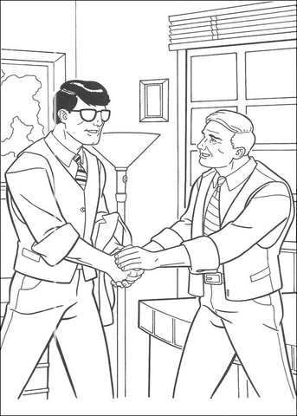
Conclusion
Journalism has not been studied by the computer security community and thus existing tools are not widely used.
Existing tools are not used due to usability issues and a mismatch between assumed and actual practices, priorities, and constraints of journalists.

Slide 31
Questions
What is one way journalists get around sources increasing reluctance to communicate?
What is one of the major reasons that security tools are not widely adopted by journalists?
What is a major tool that the study found that journalists desire but lack?

